Slide 1
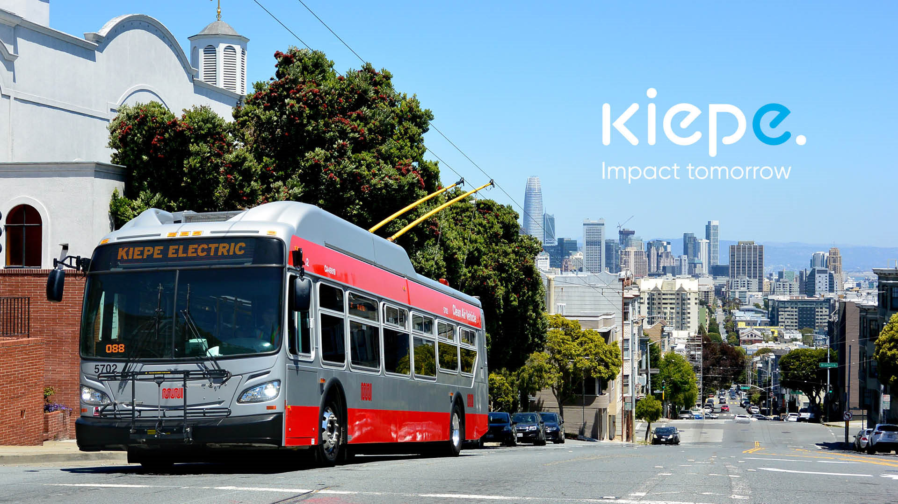

Slide 2
26/Nov/2024
Session 3: In Motion Charging, Batteries and Energy Management
Marta WORONOWICZ, Klaus Peter CANAVAN

Slide 3
TRAINING AGENDA
Battery chemistry
Basics on electrics (Power vs Energy, charging and charging time)
Basics of electrical bus
Difference between In Motion Charging buses and battery buses
Double insultation requirement
Current collector (how to connect2charge)
Charging e-buses using the In Motion Charging infrastructure

Slide 4
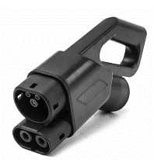

Definitions
Trolley bus:
electric bus that draws power from dual overhead wires using spring- loaded trolley poles (Wikipedia)
IMC:
In Motion Charging
IMC buses charge traction batteries “en route” enabling off-wire operation for long distances.
Additional charging options: depot (e.g. using standard CCS connector)
A well-designed IMC system allows to simplify infrastructure (reduce overhead by 70%). Outskirts and additional routes can be served without wire.

Slide 5

The Physics
Energy = Power x Time
What is the difference between kW and kWh?
Energy
[Wh]
Power
[W]
Time
[h]

Slide 6

How does the energy get to the bus?
Battery discharge during the day
0h
9h
18h
e.g. 300 kWh per bus per day (18 h of service)

Slide 7
How does the energy get to the bus?
Depot charging (overnight)
Charging station
30,000 kWh consumed
Time to recharge: 3 hrs
P
[MW]
10 MW
30,000 kWh / 3h = 10 MW
or 100 kW per bus
10
8
1.7 MW
6
1h
4
100 buses
2
3 hrs
Time [h]
time for charing = bottleneck → large amount of power required

Slide 8
How does the energy get to the bus?
Optimized depot charging (overnight)
Charging station
300 buses
30,000 kWh consumed
Time to recharge: 5 hrs
P
[MW]
100 buses
1.7 MW
10
1h
8
7 MW
6
4
2
5-6 hrs
Time [h]
Optimized charging pattern → power required reduced
But what if we need to charge 300 buses…

Slide 9
Infrastructure requirements
Depot charging, opportunity charging and IMC
IMC: ? % utilization
Overnight:
19% utilization
Opportunity:
37% utilization
P
[MW]
10
8
7 MW
6
4
3.5 MW
1.7 MW
2
…
Time [h]

Slide 10
Infrastructure requirements
Depot charging, opportunity charging and IMC
IMC: 75% utilization
Overnight:
19% utilization
Opportunity:
37% utilization
Remaining 25% can be used to charge EVs during the night
P
[MW]
10
8
7 MW
6
4
3.5 MW
1.7 MW
2
…
Time [h]
IMC infrastructure requires lowest installed power
and has highest utilization → lowest substation cost

Slide 11
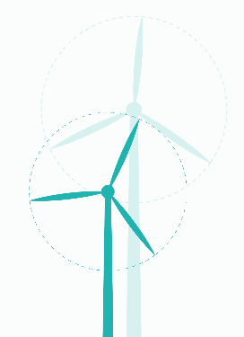
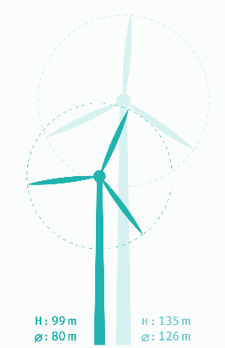
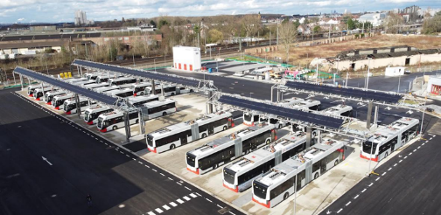
Infrastructure requirements
Depot charging for 100 buses
Overnight charging at 100kW: 100kW x 100 buses = 10MW
Energy for 3 hours of charging: 300kWh per bus or 30MWh total
Typical trolley bus substation: 750V x 1000A = 0.75MW
Depot for 100 battery buses needs installed power of 13 substations!
10MW / 0.75MW = 13 substations (175 small / 4-5 large wind turbines)

Slide 12
Difference IMC / Battery Bus
IMC
  Traction batteries charged en route
  Battery capacity optimized (energy, weight, cost) for the local requirements of the operator
  A powerful battery allows the same driving performance as a trolley bus
Battery Bus
  Traction batteries are charged in the depot during the night
  Challenging requirements for charging infrastructure
  High charging power during the night
  OR
  Batteries are charged at stops (opportunity charging)
  Minimum charging times required to get to the SOC needed to operate the next route
  Delays in the schedule are hard to compensate
  Wait times may require additional buses and operators
Bus needs to operate to create revenue
Time is money = money is time
No need for additional buses and operators
Carry passengers not batteries

Slide 13
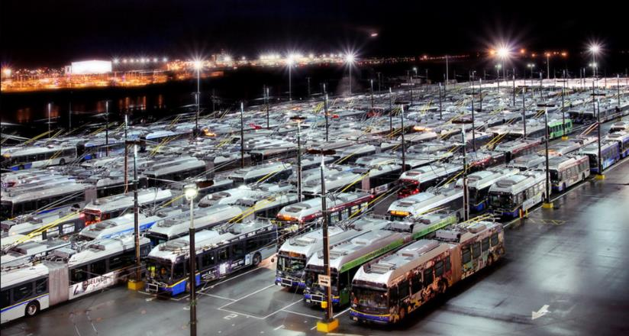
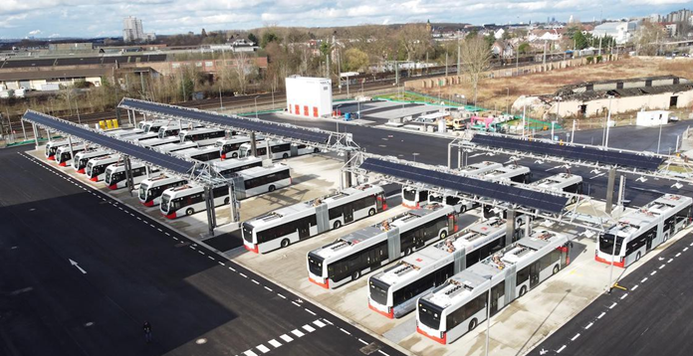
Difference IMC / Battery Bus depot
IMC
  Parked bumper to bumper, mirror to mirror
  Smallest possible parking/depot area
Battery Bus
  Space needed for charging infrastructure, fire safety…
Philip Tong photo, flicker - KVB

Slide 14
IMC
Applications for IMC
Suburban
Conversion to IMC
Downtown
Suburban
Downtown
Suburban
Suburban
OHL Mode
ESS Mode
Extension of the existing over headline (OHL) routes using battery mode
Decarbonization by switching from Diesel to IMC

Slide 15
IMC
Applications for IMC
Conversion to IMC
Downtown
Downtown
OHL Mode
ESS Mode
“De-cluttering” of downtown areas, especially of historic old town areas
Less “spider webs” at intersections

Slide 16
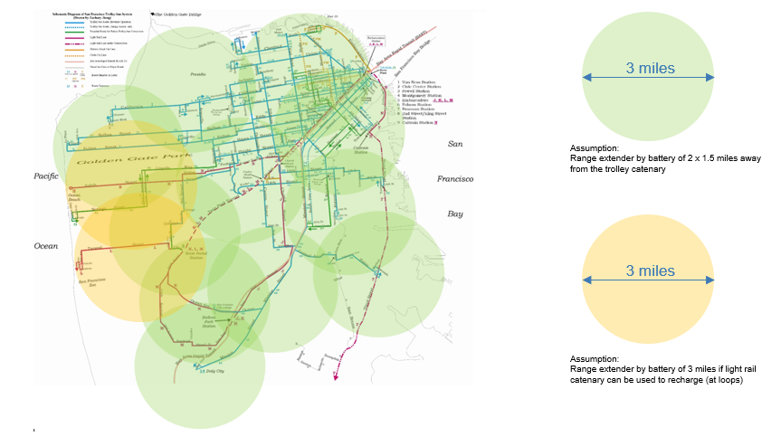
IMC
Extend trolley routes by 2x 1.5 miles using IMC
Extend trolley routes by 2x 1.5 miles using streetcar terminus

Slide 17
Use of existing Infrastructure
IMC alternatives?

Slide 18
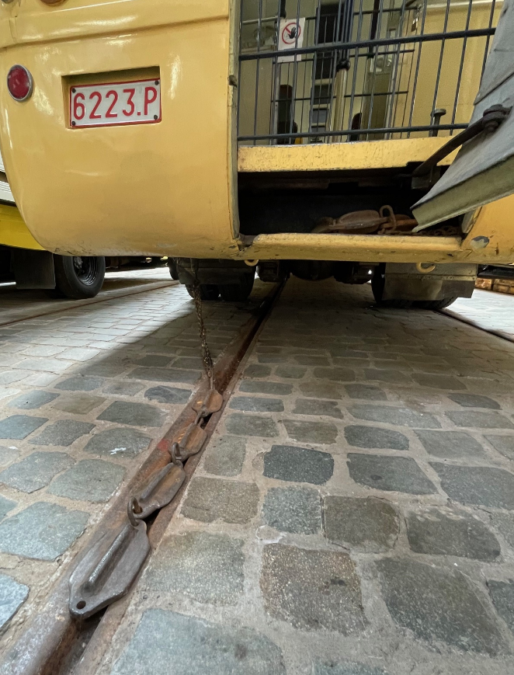
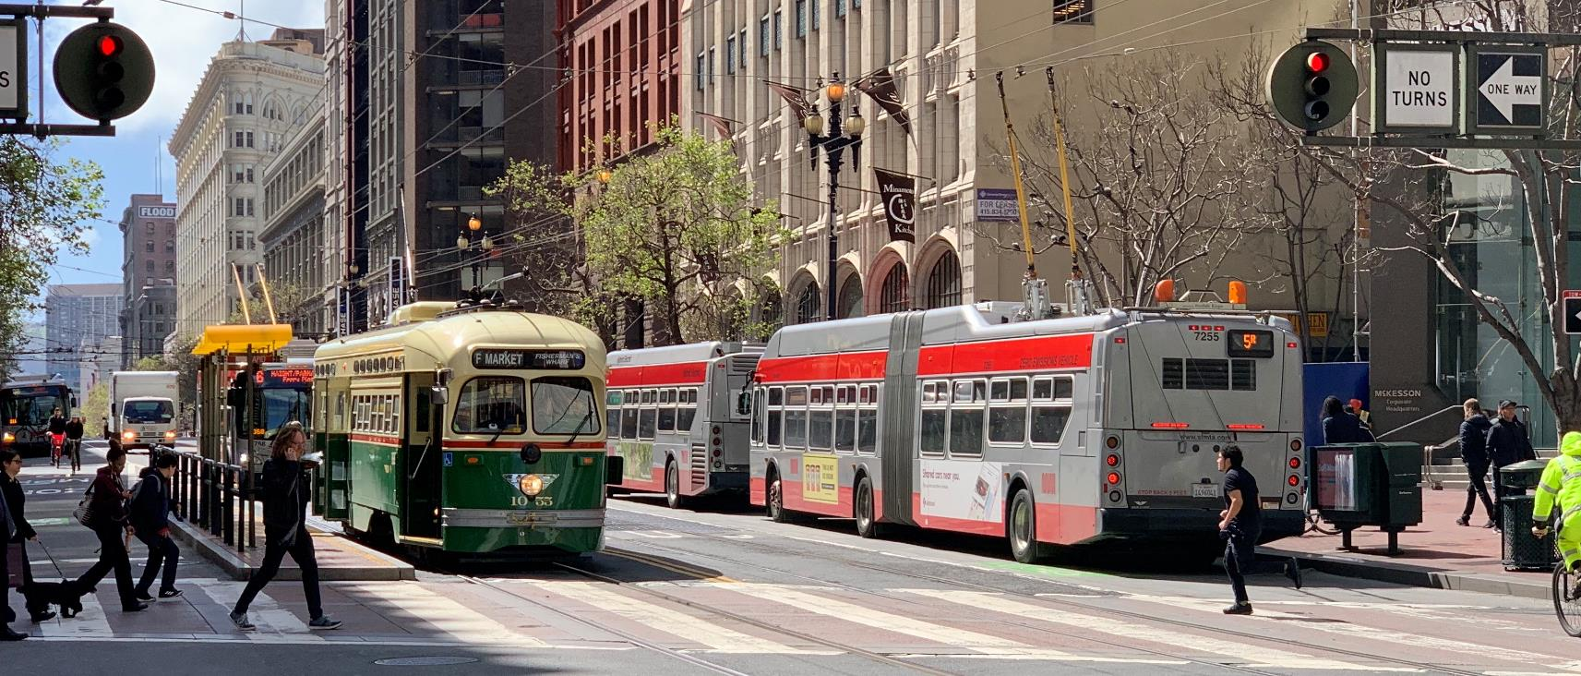
Klaus P. Canavan photo

Slide 19
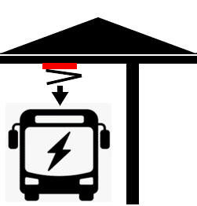
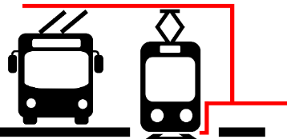
Charging solutions
Control system
Uni-/bi-directional
DC/DC converter
Bidirectional
DC/DC converter
Batteries
IMC / streetcar overhead line
Regeneration of energy
Stabilization of power
Converter connected directly to overhead line
Storage of regenerated energy
Peak shaving and load balancing
Controller for charging
Battery bus
charging station
Use of existing overhead line infrastructure

Slide 20
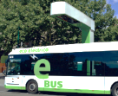
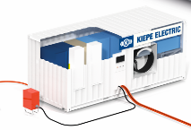
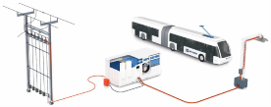
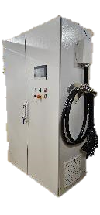
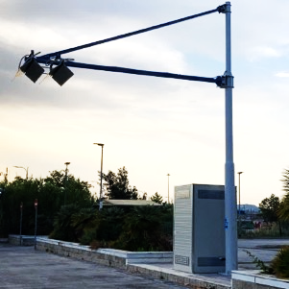
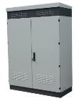
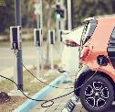


Product Examples
© Furrer+Frey
Mainline K-Charger
Charging stations with 100 - 800 kW
Mobile K-Charger
Mobile Charging Station 100 - 800 kW
Megawatt K-Charger
Charging of e-trucks
1000 - 3000 kW
City K-Charger
Charging with pantograph 100 – 800 kW
Overhead Line
3x480VAC, 60 Hz
EV K-Charger
Power Supply for EV-Wallboxes 100 – 800 kW
Depot K-Charger
Charging of battery bus
e.g. 2 x 100 kW
Standard K-Charger
Charging with 100 - 200 kW
Trolley Bus K-Charger
Charging Station for IMC bus 100 - 300 kW

Slide 21
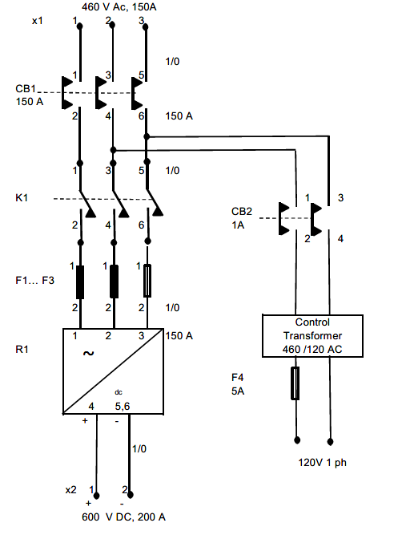
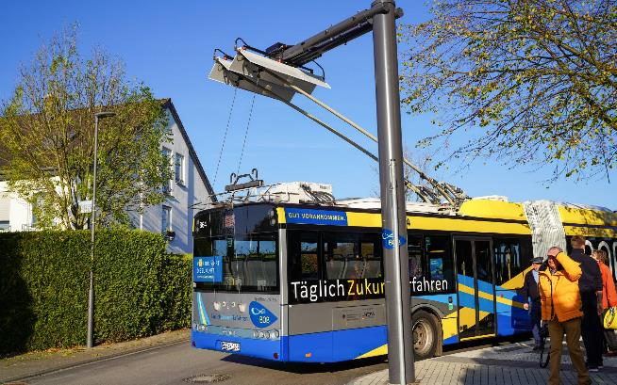
IMC Bus Infrastructure
Simple 600/750V DC voltage source
Only passive rectifier and switchgear required
No communication with external charging station interoperability!
RP online photo (BOB Solingen)

Slide 22
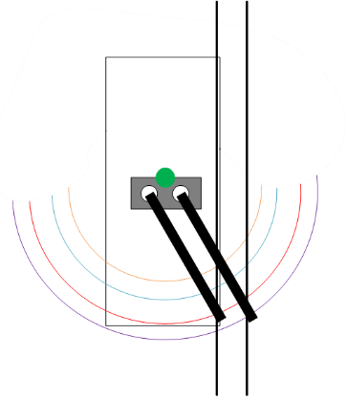
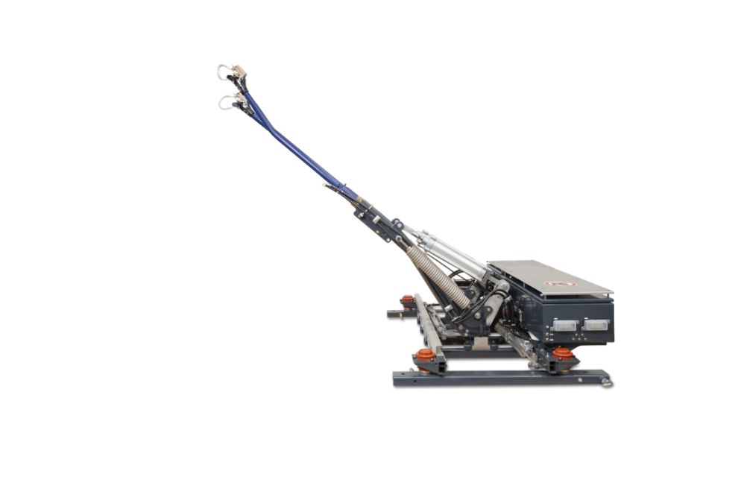
Connect to Charge
Ways to connect to the charging infrastructure
  Traditional
    Manual re-wiring, requires the operator to leave the bus
  Automatic using troughs
    At dedicated spots, requires precise alignment of the bus
  Fully automatic
    Either at dedicated stops
    With or without troughs
    With or without possibility to move laterally

Slide 23
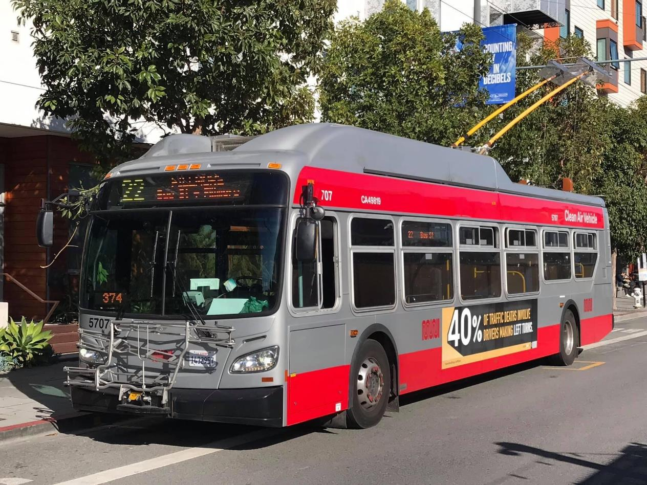
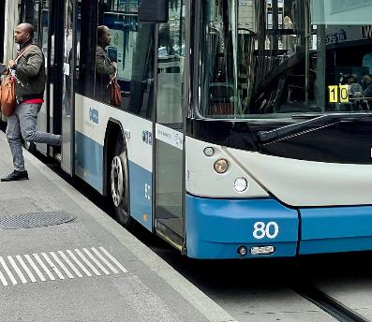
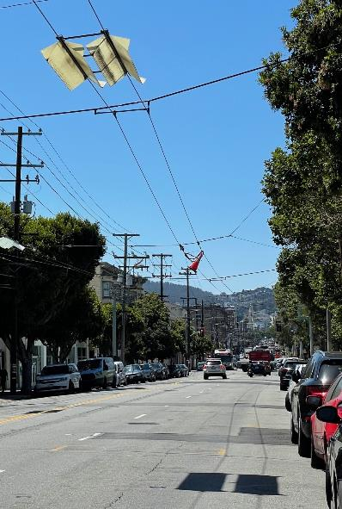
✓
✓
✗
Matthew Lee photo used with permission, other photos: KP Canavan

Slide 24
Relevant Standards
IEC 63076:2019 (based on EN50502 / with reference to various other IEC standards)
Railway applications - Rolling stock - Electrical equipment in trolley buses
Safety requirements and current collection systems
ECE R-107
Uniform provisions concerning the approval of category M2 or M3 vehicles with regards to their general construction
Annex 12 (additional safety requirements for trolley buses)
For example: ECE R-107 Annex 12 / IEC63076: 2019

Slide 25
IMC Bus Architecture
Double insulated traction
Traction equipment directly connected to overhead line
No conversion losses
Regenerative braking into overhead line and onboard (battery and aux.)
+/- 600V / 750V DC
Current
Collector
Traction
Battery
AUX

Slide 26
IMC Bus Architecture
Galvanic insulation from overhead line using DC/DC converter
Components downstream of DC/DC can be standard battery bus single insulated design if standard is met
Current collector and DC/DC require double insulation
Insulation monitoring (hot coach detector)
Insulation of doors!
Regeneration into battery
+/- 600V / 750V DC
Current
Collector
DC/DC
Traction
Battery
AUX

Slide 27
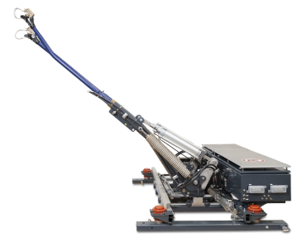
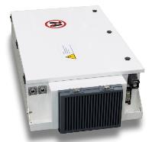
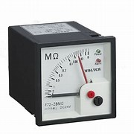
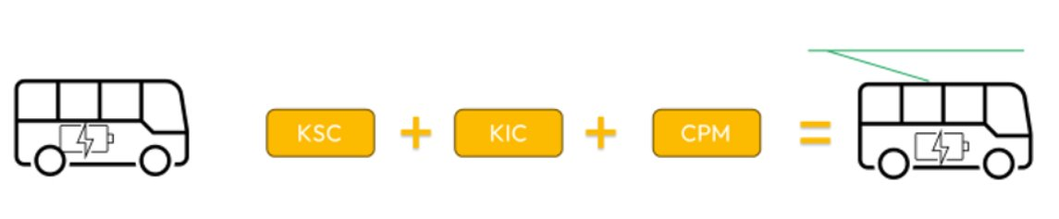

Battery Bus Charging
Current
Collector
DC/DC
ISO test
DC/DC converter = trolley line interface and on-board battery charger

Slide 28
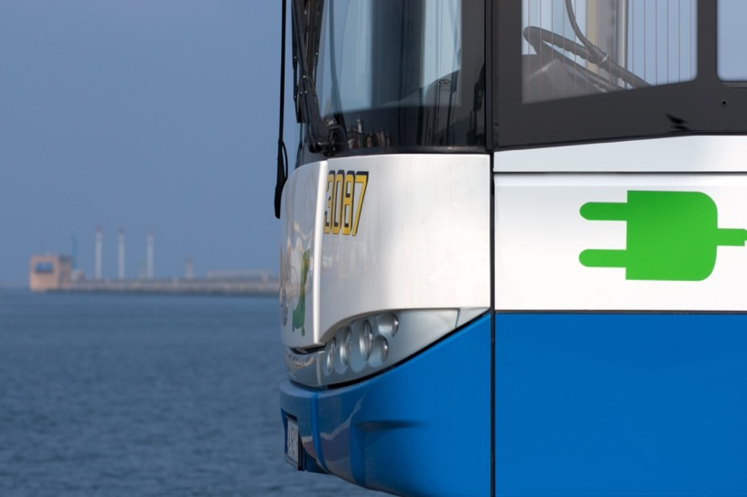
Flexibilty and intermodality of the trolley bus grid in the trolley bus system it is possible to install:
A photovoltaic power plant feeding solar power directly into the trolleybus grid
Energy supercapacitors
Charging points for other EV vehicles

Slide 29
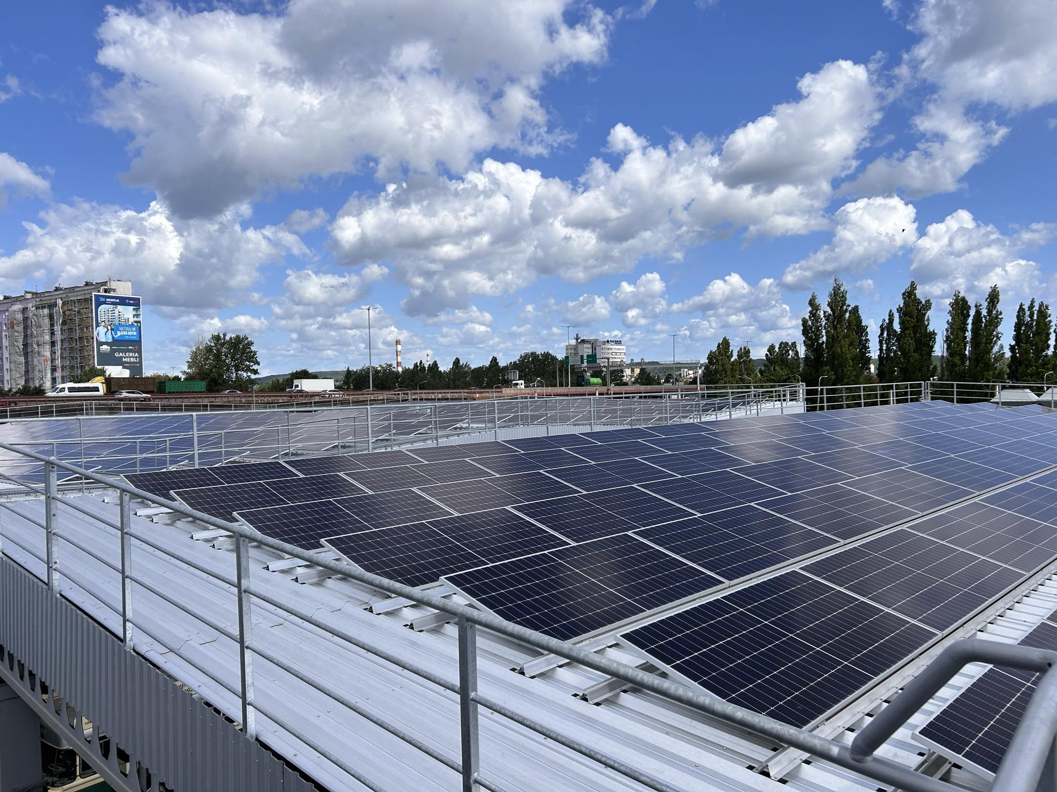
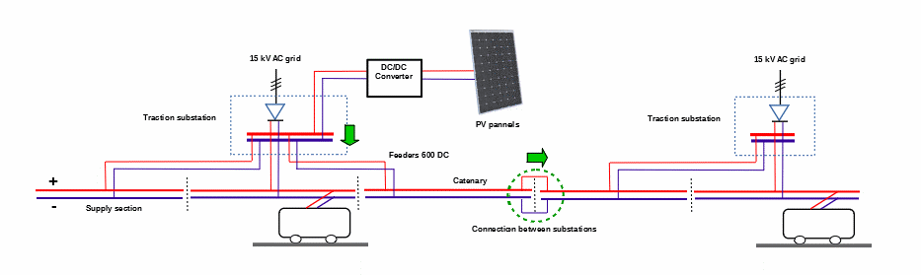
pv plant feeding solar power directly to trolleybus grid in gdynia, poland trolleybus depot
PV power plant on the roof of the parking places in Gdynia, Poland trolley bus operator depot
5 000 M2, 499 kWp
5% of the total trolley bus grid energy demand
Without connection to the energy provider power grid - power generated from a PV plant fed directly to the overhead wired infrastructure

Slide 30
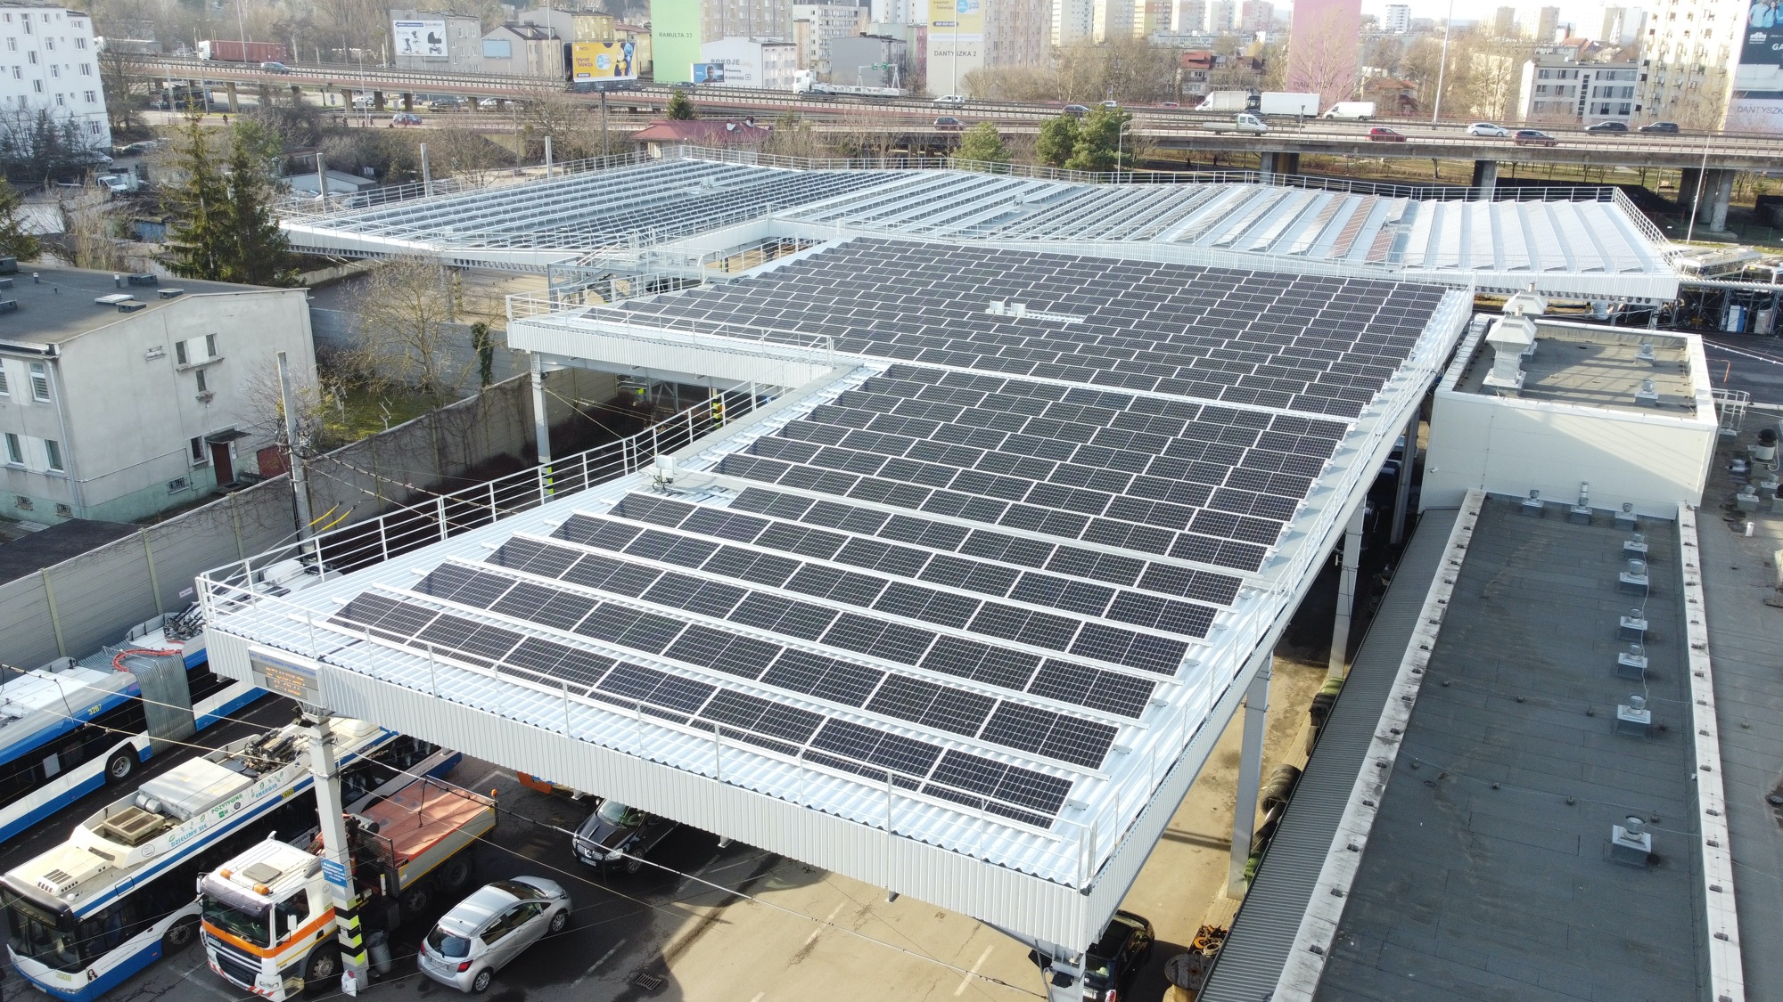

Slide 31
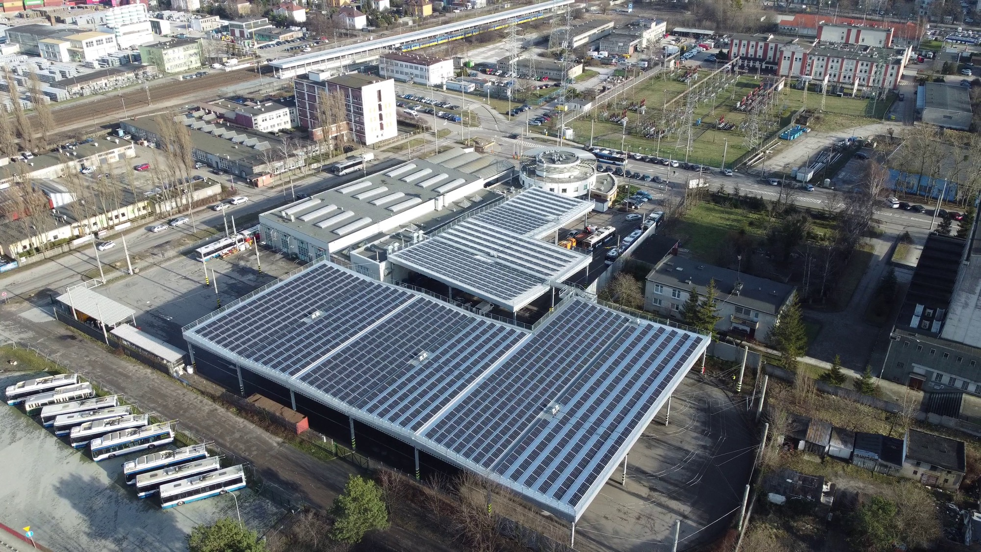

Slide 32
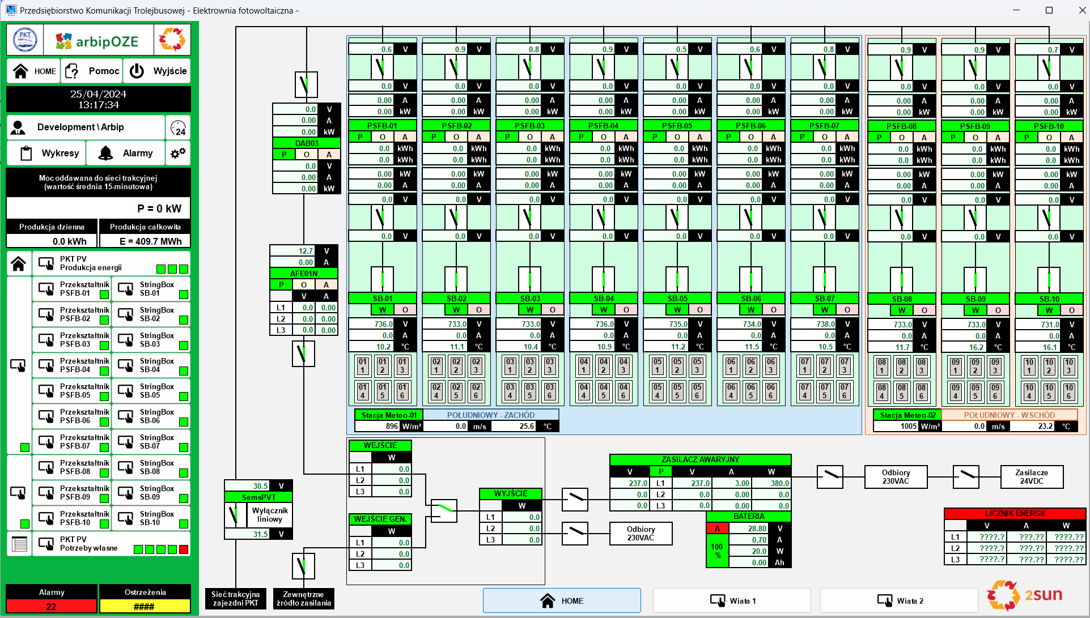

Slide 33
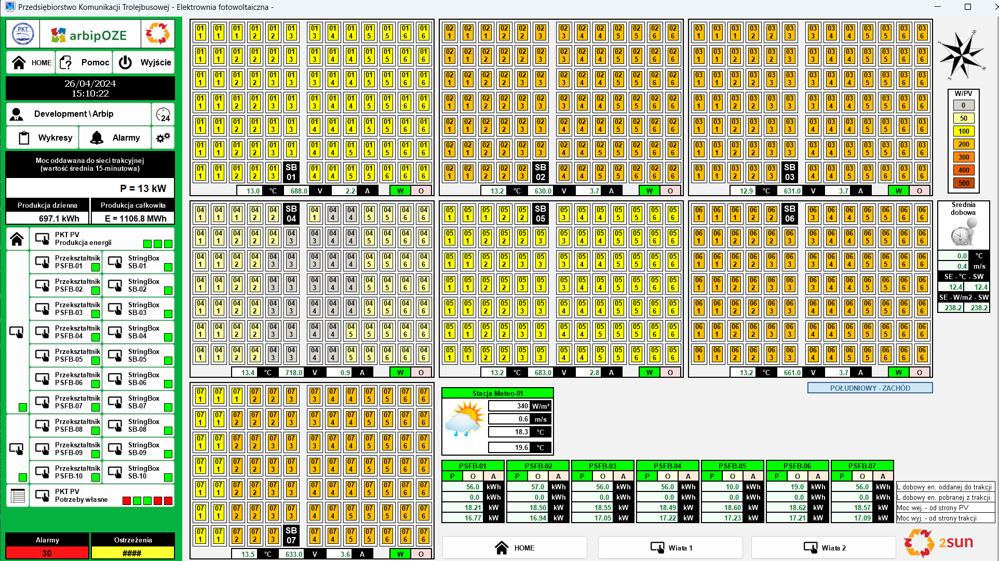

Slide 34
Studies on shared PV system between residential and traction grids

Slide 35
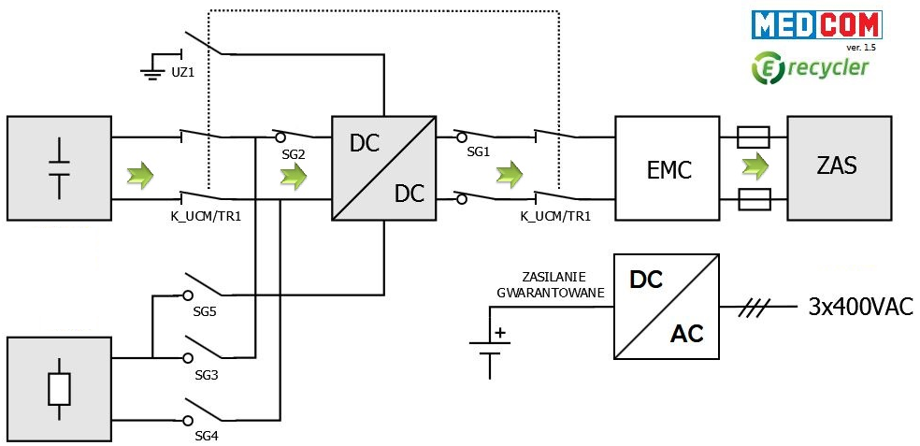
Supercapacitor Storage Energy System
Capacity 1.5 kWh
Max. Power 500 kW
Producer MEDCOM

Slide 36
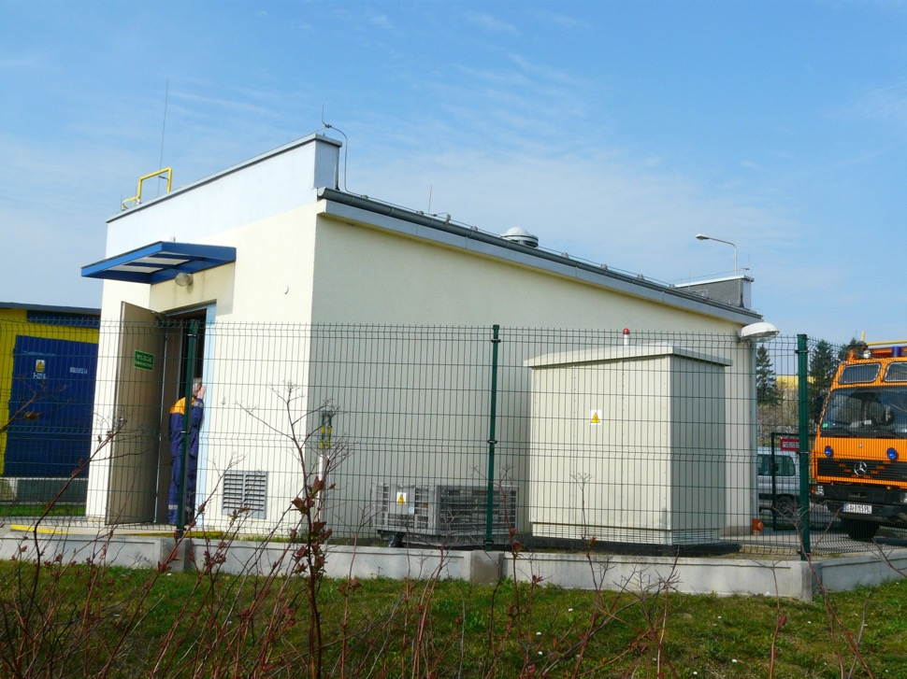
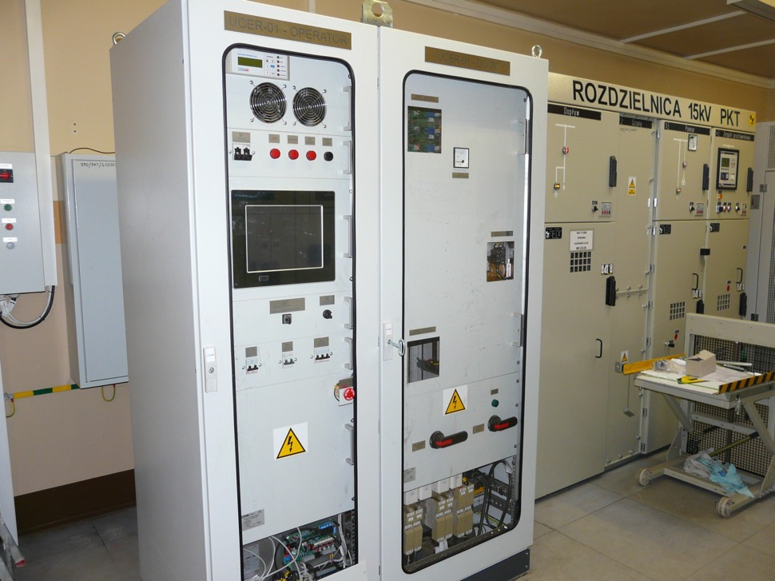

Slide 37
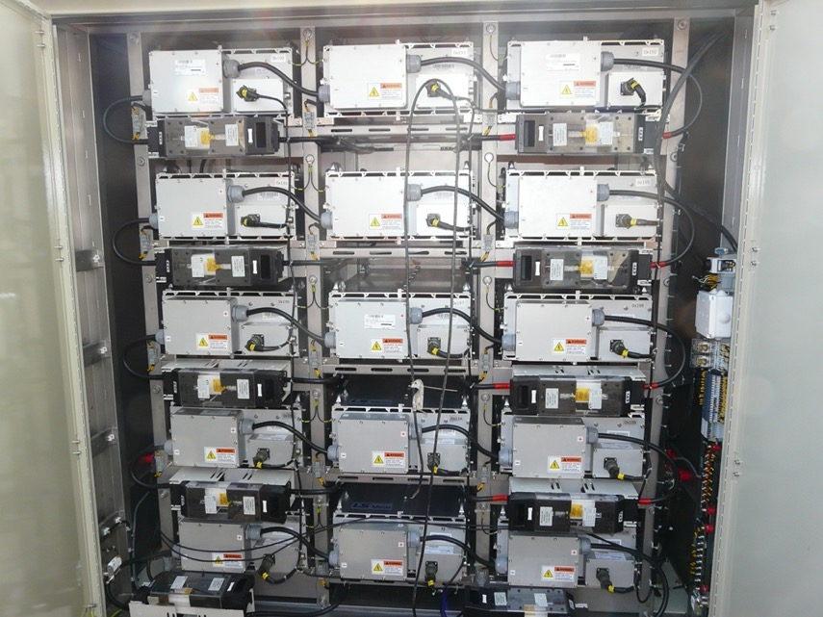
Energy savings
A supercapacitor for storing braking energy – installed in one of the substations placed in the hilly area of the city
20% energy savings
on the section

Slide 38
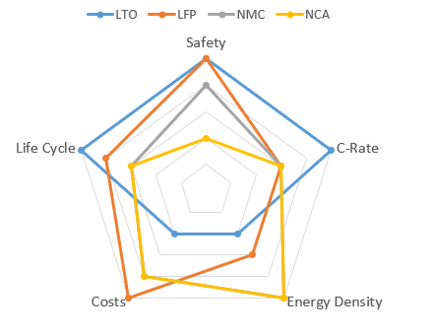
Battery Chemistry
Cell Chemistry | LTO | LFP | NMC | NCA
Pros | Very High Safety Very high Cycle Life Fast Charge/ Discharge C-Rate | Very High Safety Low costs | Highest Energy Density | Highest Energy Density
Cons | Lowest Energy Density High costs | Lower Energy Density | Lower Safety | Lower Safety

Slide 39
Origins of imc trolleybuses in Gdynia
In 2009 - preparation for the fleet modernization co-financed by EU funds
Basic requirement for the new fleet – auxiliary drive allowing for autonomous operation of trolleybuses
Diesel drive
long distatance
flexibility
popular solution
Battery
promising technology
zero emission
easy maintenance
(„all electric“)
Decision makers

Slide 40
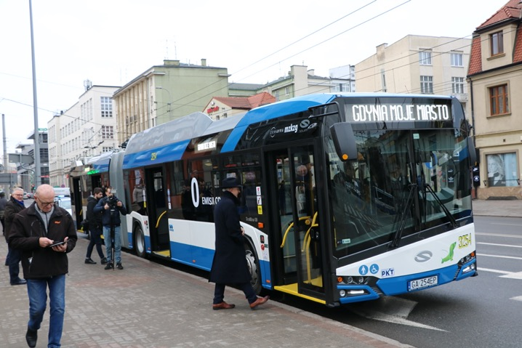
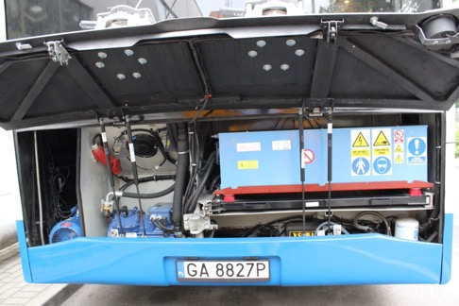
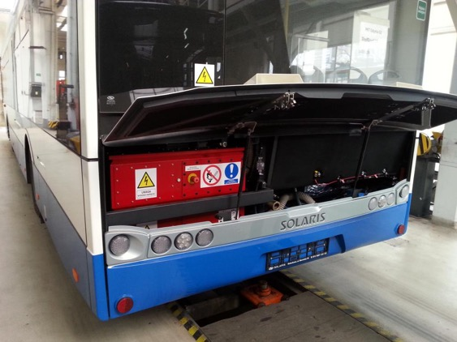
Batteries used in Gdynia trolleybuses
Ni-Cd battery
capacity: 6-16 kWh
range: 3-5 km
Li-Ion battery
capacity: 27 & 69 kWh
range: ca.15 & 30 km
LiFePO4 battery
capacity: 40 kWh
range: ca. 20 km
LTO battery
► capacity:
58 (12m) & 87 kWh (18m)
►range: ca. 35 km

Slide 41
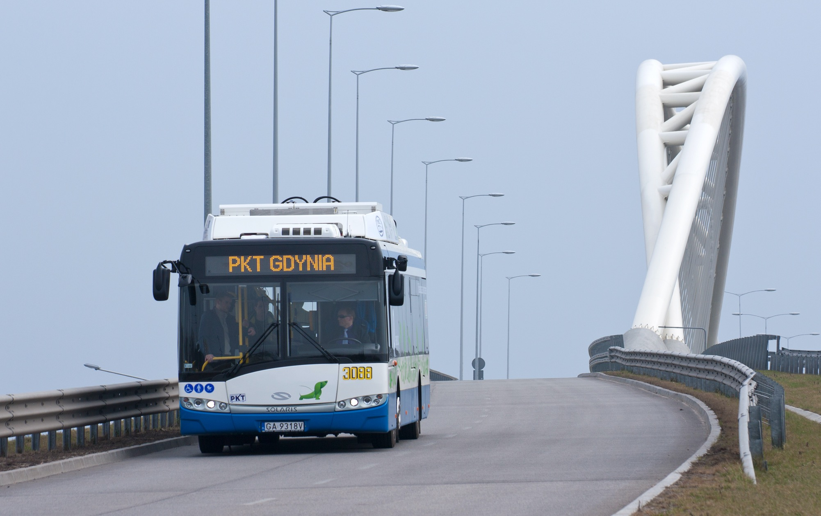

Slide 42
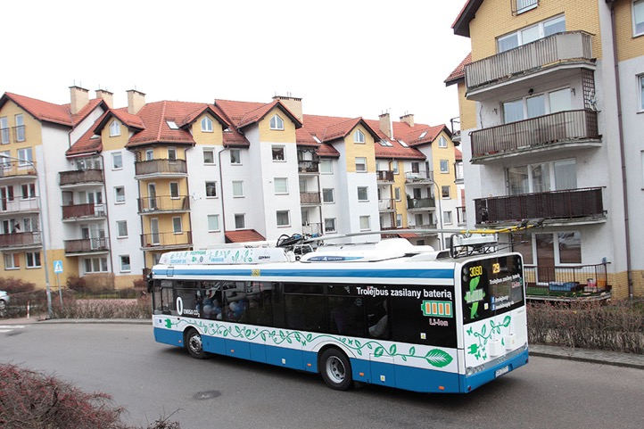
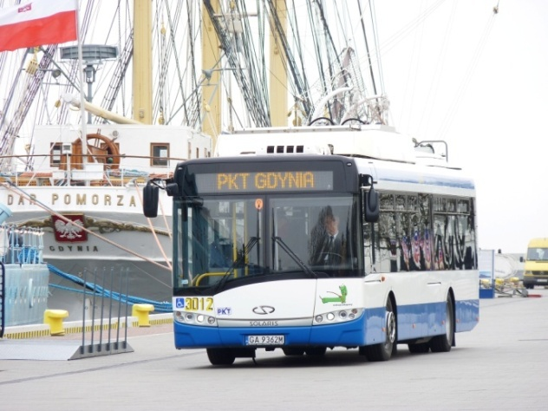
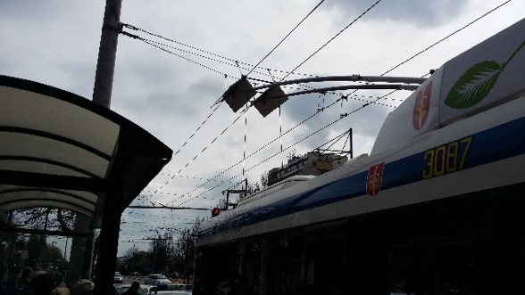
IMC in use - regular off wire operation in gdynia
50 % of the lines are extended (9 of 18)
Automatic lowering and raising of current collectors

Slide 43
Other european imc lighthoue examples
  Biel, Switzerland
  Solingen, Germany
  Cagliari, Italy
  Prague, the Czech Republic
  Arnhem, the Netherlands

Slide 44
Take aways
Energy = Power x Time
Electrification requires Power and Space
IMC buses carry passengers not batteries (low power, less space)
IMC buses can re-wire automatically
Mixed use of IMC infrastructure is possible (observe standards)
IMC: key technology to help remove roadblocks to electrification

Slide 45
QUESTIONS?

Slide 46




THANK YOU!
trolleymotion.eu
woronowicz@trolleymotion.eu
kiepe-group.com
klauspeter.canavan@kiepe-group.com

